Slide 1


Introduction to the Project
Welcome to our presentation on the process of building a website that displays GitHub user profiles. In this section, we'll provide an overview of the project, outlining the key technologies and modules used to create this interactive web application.

Slide 2

Overview of the Website
This website is designed to provide an easy and intuitive way for users to search for and view GitHub user profiles. With a clean and responsive interface, users can simply enter a GitHub username and instantly see the user's profile information, including their bio, repositories, and activity.

Slide 3

HTML Structure and Components
At the core of our website lies a robust HTML structure, crafted to provide a solid foundation for the user interface. We've carefully designed semantic elements and intuitive layouts to ensure a seamless and accessible experience. By using appropriate HTML tags and following best practices, we've created a well-organized and standards-compliant codebase that is easy to maintain and extend.
The HTML structure of our website is divided into several key components, each serving a specific purpose and working together to deliver the overall functionality. From the document structure defined by the <html>, <head>, and <body> elements to the carefully chosen semantic tags like <header>, <nav>, <main>, <section>, and <footer>, we've ensured that the HTML markup accurately reflects the content and meaning of the website.
Additionally, we've incorporated various HTML components such as forms, tables, lists, and media elements to enhance the interactivity and presentation of the user interface. By leveraging the power of HTML, we've created a foundation that is not only visually appealing but also highly accessible and optimized for search engines and screen readers.

Slide 4

CSS Styling and Responsive Design
With a focus on sleek visuals and seamless user experiences, we've meticulously crafted the CSS styling for our GitHub profile website. Our responsive design ensures the application looks stunning on any device, from desktops to mobile phones. We've paid close attention to every detail, optimizing the layout, typography, and color scheme to create a visually appealing and intuitive interface that enhances the overall user experience.
By incorporating the principles of responsive web design, we've made sure that our GitHub profile website adapts flawlessly to different screen sizes and devices. Whether users are accessing the site on a large desktop monitor or a compact smartphone, the content and layout will automatically adjust to provide the best possible presentation. This level of responsiveness is crucial in today's mobile-centric world, ensuring that our users can easily access and interact with the site no matter where they are or what device they're using.

Slide 5

JavaScript Functionality
To power the dynamic user experience, we've leveraged the power of JavaScript. Our application utilizes JavaScript to handle user interactions, fetch data from the GitHub API, and seamlessly update the web interface in real-time.

Slide 6
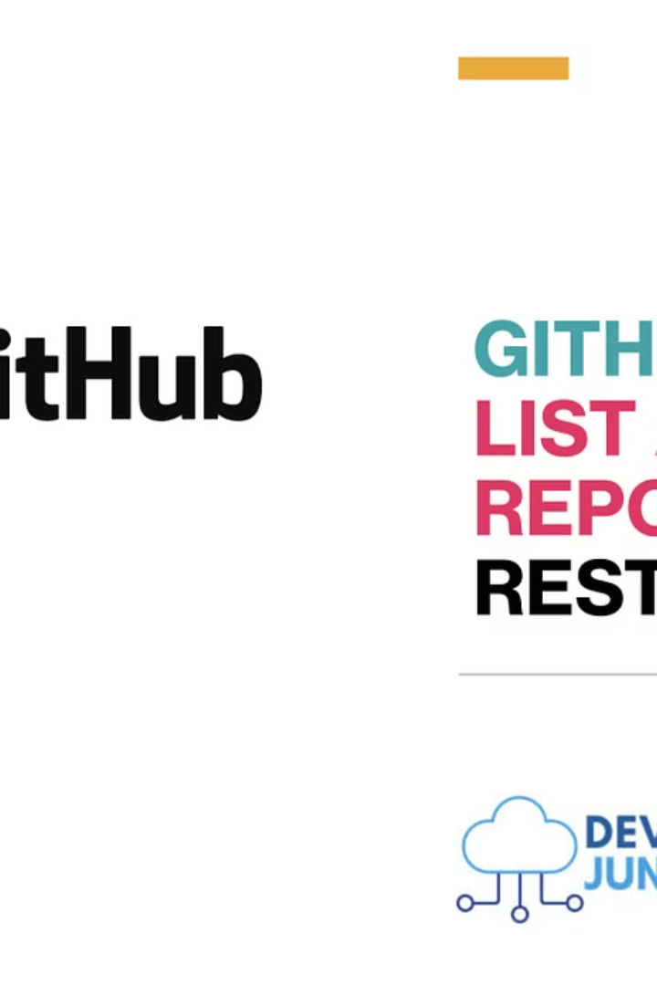
Fetching GitHub User Data
To retrieve the GitHub profile information, our application utilizes the powerful GitHub API. By sending secure HTTP requests to the API endpoints, we can dynamically fetch the user's details, including their avatar, bio, repositories, and activity history.

Slide 7
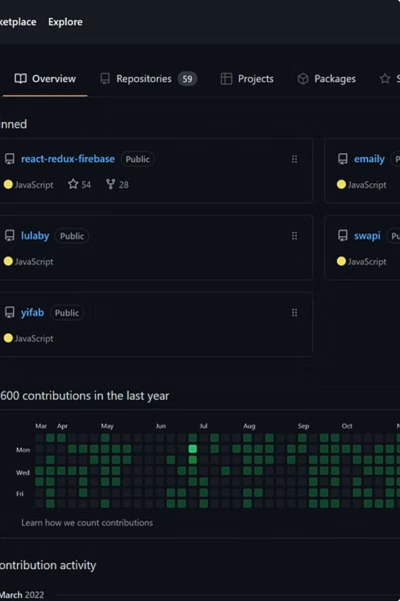
Displaying User Profile Information
With the GitHub user data successfully fetched, our application seamlessly integrates and presents the profile information in a clean and visually appealing layout. Users can instantly view the user's avatar, bio, repository details, and activity history, providing a comprehensive overview of their GitHub presence.
By clearly displaying the user's profile picture, followers, following, and other key metrics, we ensure that visitors to the website can quickly get a sense of the user's online identity and contributions. The bio section allows the user to provide a personal introduction, while the repository and activity sections showcase their coding skills and project involvement.
Our team has put a lot of thought and care into designing the user profile layout, ensuring that it not only looks aesthetically pleasing but also provides an intuitive and engaging user experience. We believe that a well-organized and visually striking presentation of the GitHub user's information is key to making a positive first impression and highlighting their accomplishments effectively.

Slide 8

Error Handling and Edge Cases
To ensure a seamless user experience, our GitHub profile website includes robust error handling and addresses potential edge cases. We've implemented intuitive error messages, graceful fallbacks, and comprehensive data validation to provide users with a reliable and responsive application.

Slide 9

Deployment and Hosting
With the website development complete, we turn our focus to deployment and hosting. We've selected a reliable cloud platform to securely host the GitHub profile application, ensuring lightning-fast load times and seamless user experiences across the globe. By leveraging the power of cloud computing, we can guarantee high availability, scalability, and robust security for our users.
Our choice of cloud hosting provider was driven by their industry-leading performance, comprehensive security features, and user-friendly management tools. This allows us to focus on delivering an exceptional user experience, while the cloud platform handles the underlying infrastructure and maintenance tasks. With global data centers and content delivery networks, we can ensure that our GitHub profile website is accessible to users around the world with minimal latency.

Slide 10

Conclusion and Next Steps
With the development of our comprehensive GitHub profile website complete, we're excited to deliver a powerful tool that simplifies the process of discovering and exploring GitHub users. As we move forward, we're committed to continuously enhancing the application, incorporating user feedback, and exploring new features to provide an even more seamless and engaging experience.

